Slide 1
Computer Networks
Dr. Upasana Dohare
(Associate Professor, GLBITM)

Slide 2
Computer Networks
Collection of autonomous computers interconnected by a communication channel.

Slide 3
Introduction
Network Hardware
Network Software
Reference Models
Example Networks
Example Data Communication Services
Network Standardization
Chap. 1 - Introduction

Slide 4
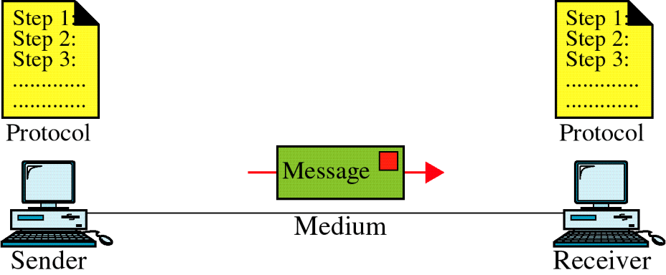
Introduction
Motivation for Networks
Information Access
Sharing of Resources
Facilitate Communications
What A Network Includes
Transmission hardware
Special-purpose hardware devices
  interconnect transmission media
  control transmission
  run protocol software
Protocol software
  encodes and formats data
  detects and corrects problems
Chap. 1 - Introduction

Slide 5
What A Network Does
Provides communication that is
  Reliable
  Fair
  Efficient
  From one application to another
Automatically detects and corrects
  Data corruption
  Data loss
  Duplication
  Out-of-order delivery
Automatically finds optimal path from source to destination
Chap. 1 - Introduction

Slide 6
Transmission Technology:
Broadcast Link -
Single channel with multiple machines connected to it.
Point-to-point Link -
Individual connections between pairs of machines.
Packets -
Messages - the "chunk" of data transmitted from one machine to the next.
Addressing -
+ One to one: Packet contains specific target address.
+ Broadcasting: All machines on the network receive and
process the packet.
+ Multicasting: A subset of machines receive and process the packet.
Chap. 1 - Introduction

Slide 7
Types of Networks
1. Personal Area Network (PAN)
2. Local Area Network (LAN)
3. Campus Area Network (CAN)
4. Metropolitan Area Network (MAN)
5. Wide Area Network (WAN)
Chap. 1 - Introduction

Slide 8
1. Personal Area Network (PAN)
It allows your personal devices, like smartphones, tablets, laptops, and wearables, to communicate and share data with each other. PAN offers a network range of 1 to 10 meters
2. Local Area Network (LAN)
LANs are Privately owned. Can be up to one kilometers long;
  Restricted so worst case transmission time can be contained.
  Run at speeds of 100, or more Mbps.
  Low delay. High reliability.
  3. Campus Area Network (CAN)
  CAN is bigger than a LAN but smaller than a MAN. CAN mainly use Ethernet technology with a range of few kilometers.
Chap. 1 - Introduction

Slide 9
4. Metropolitan Area Network (MAN)
This network mainly uses FDDI, CDDI, and ATM as the technology with a range from 5km to 50km. Its transmission speed is average. It is difficult to maintain and it comes with a high cost.
5. Wide Area Network (WAN)
WANS are Networks spanning large distances.
WAN can also be defined as a group of local area networks that communicate with each other
Chap. 1 - Introduction

Slide 10
Ethernet:
  IEEE 802.3.
  Bus based broadcast network with decentralized control at 10 or 100 Mbps.
Token Ring:
  IEEE 802.5
  Ring based broadcast network with token arbitration at 4 or 16 Mbps.
Chap. 1 - Introduction

Slide 11
WIDE AREA NETWORKS
WANS are: Networks spanning large distances.
Hosts or End Systems -
Machines running user applications.
(Communication) Subnet -
Connections between hosts - transmission lines + switches.
A "locality" understanding each other's addresses.
Circuits/Channels/Trunks -
Transmission lines move the bits.
Packet switching nodes/Intermediate systems/Data switching exchanges
Specialized computers moving data between several inputs
to several outputs.
Router - Generic term for switching computers.
Point-to-point/Store-and-forward/Packet-switched -
Moving through a series of routers, packets are received at a router, stored there, then forwarded to the next router.
Chap. 1 - Introduction

Slide 12
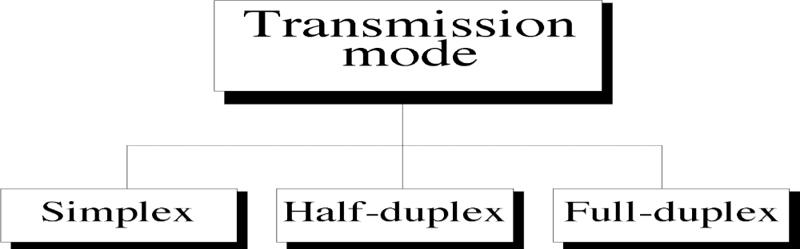
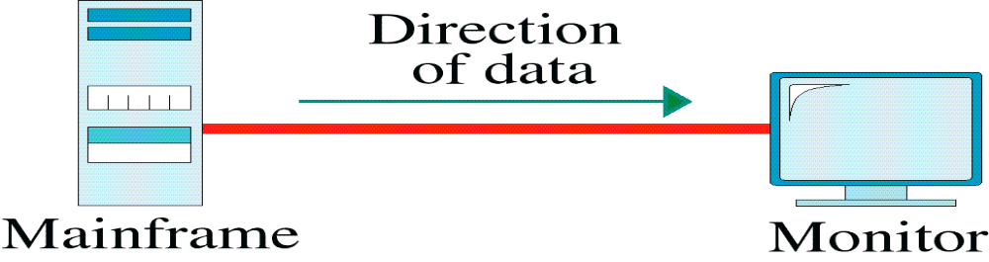
Transmission mode:
define the direction of signal flow between two linked devices.
Simplex
Chap. 1 - Introduction

Slide 13
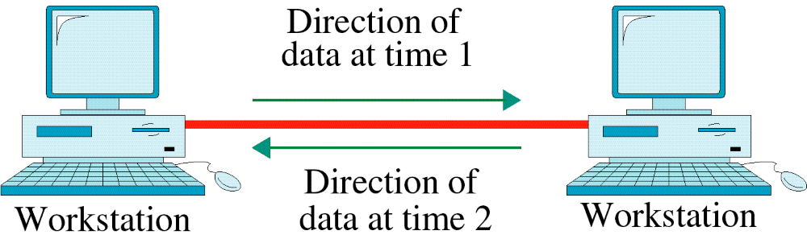
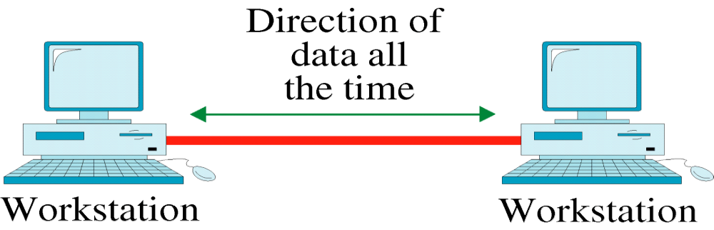
Half-Duplex
Full-Duplex
Chap. 1 - Introduction

Slide 14
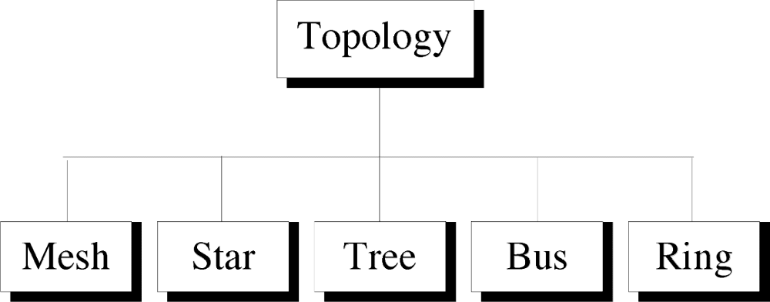
Topology
Topology defines the physical or logical arrangement of links in a network
Chap. 1 - Introduction

Slide 15
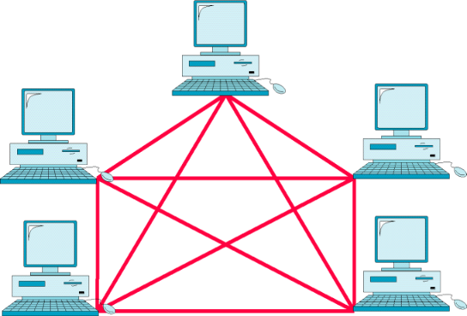
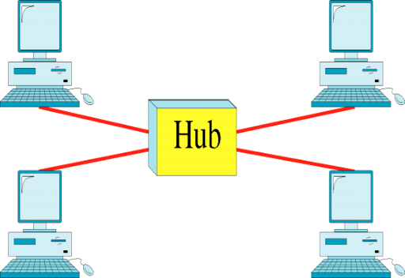
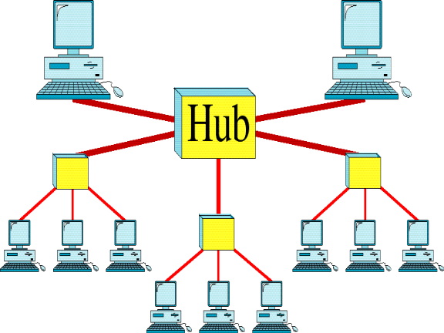
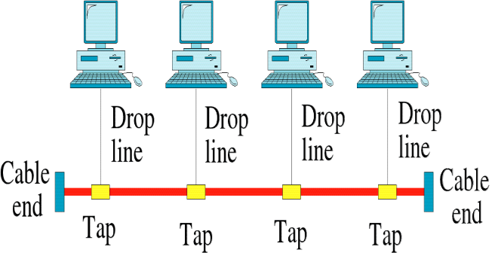
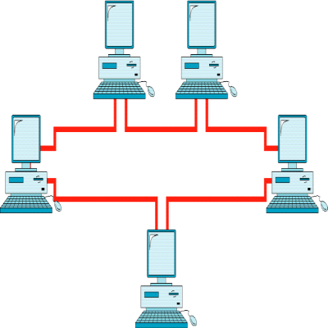
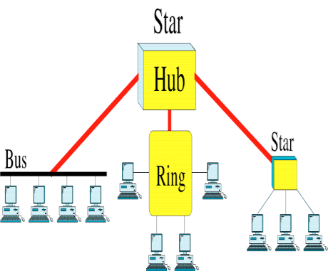
Topology
Mesh
Star
Tree
Bus
Ring
Hybrid
Chap. 1 - Introduction

Slide 16
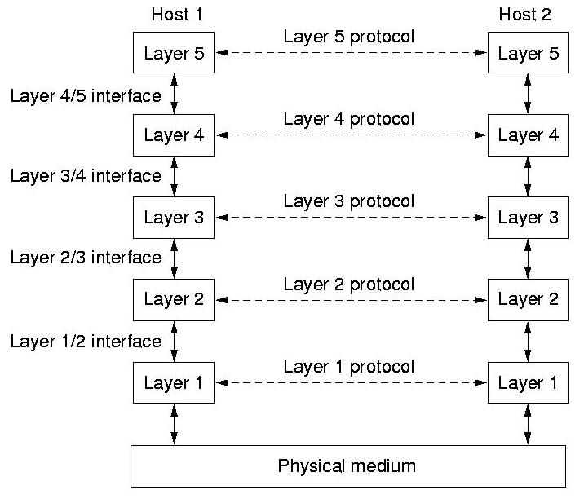
Network Software
PROTOCOL HIERARCHIES
Layers -
The concept that network software is organized functionally into levels. A level on one host talks to the same level on another host (its peer).
Protocol -
The protocol is the convention or standard that a layer uses to talk to the other layer. An agreement or standard on the conversation.
Physical Medium -
Underneath the layers is the wire or fiber or whatever.
Interface -
Defines the services that one layer offers another (either up or down.)
Important to keep this simple and clean.
Important that each layer perform specific actions.
Chap. 1 - Introduction

Slide 17
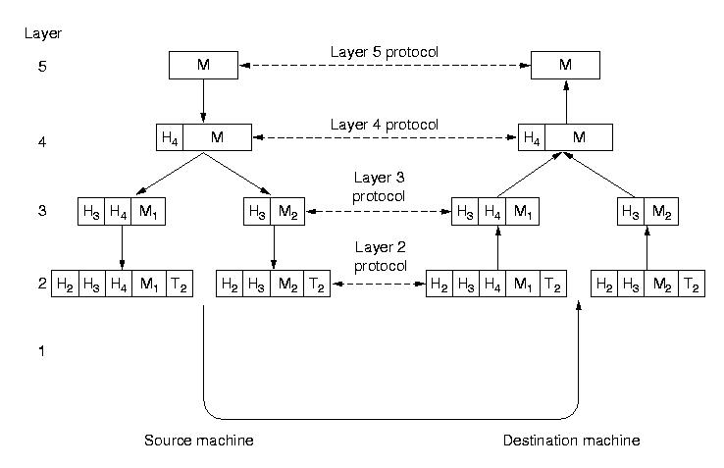
Network architecture -
A set of layers and protocols. It contains details on what happens in the layer and what the layers says to its peer.
Protocol stack -
A list of protocols used by a system, one protocol per layer.
Chap. 1 - Introduction

Slide 18
INTERFACES AND SERVICES
Purpose of each layer is to provide services to the layer above it.
Entities / Peer entities -
Active element in each layer (process/IO chip).
Peer entity = layer N entity <--> layer N entity.
Layer N entity provides service for layer N + 1.
Service providers and users -
Layer N is a provider for user N + 1.
Chap. 1 - Introduction

Slide 19
CONNECTION-ORIENTED / CONNECTIONLESS SERVICES:
Connection oriented service -
Like the phone system. The system establishes a connection, uses it, and closes it. Acts like a tube. Data comes out the other end in the same order as it goes in.
        Connection Setup
        Data Transfer
        Connection Termination
Connectionless service -
Like the post office. Each message has the entire address on it. Each
    message may follow a different route to its destination. Ordering not
    maintained.
        Data Transfer
Chap. 1 - Introduction

Slide 20
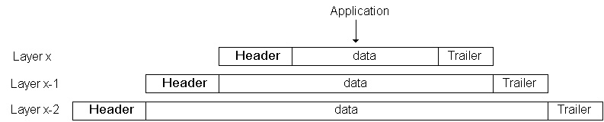
Headers, Data, and Trailers
Encapsulation
Chap. 1 - Introduction

Slide 21
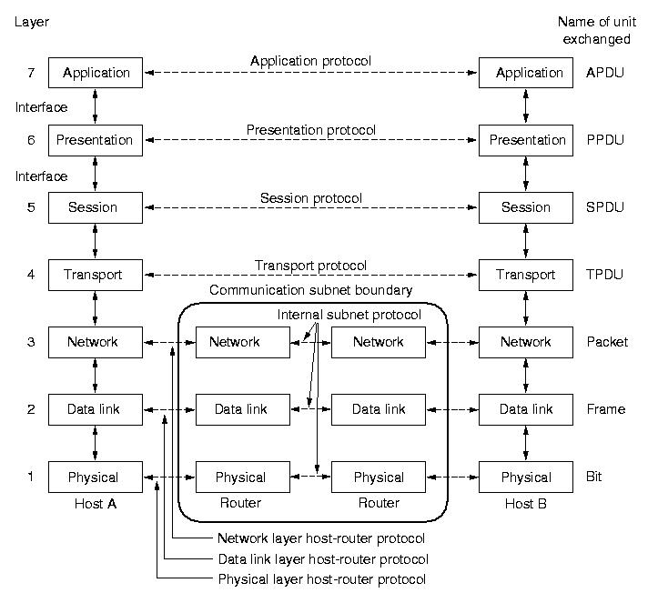
THE OSI REFERENCE MODEL
OSI == Open Systems Interconnection
Developed by ISO == International Standards Organization
Principles used to develop OSI Layering:
1. Need a layer for each different level of abstraction.
2. Each layer performs a well defined function.
3. Each layer should have standardized protocols.
4. The right number of layers - don't put too many functions together, but not too many layers either.
Chap. 1 - Introduction
Notes:
Application protocol Data Unit,

Slide 22
THE OSI REFERENCE MODEL
Physical Layer -
Purpose -- Transmits raw bits across a medium.
Representation of Bits – bits must be encoded into signals – electrical or optical
Electrical -- Concerns are voltage, timing, duplexing, connectors, etc.
Physical Topology -- star, ring, bus etc.
Transmission mode – simplex, half duplex, full duplex
Data Link Layer -
Framing -- Breaks apart messages into frames. Reassembles frames into messages.
Error handling -- solves damaged, lost, and duplicate frames.
Flow control -- keeps a fast transmitter from flooding a slow receiver.
Gaining Access -- if many hosts have usage of the medium, how is access arbitrated.
Chap. 1 - Introduction

Slide 23
THE OSI REFERENCE MODEL
Network Layer -
Routing -- What path is followed by packets from source to destination. Can be based on a static table, when the connection is created, or when each packet is sent.
Congestion -- Controls the number packets in the subnet.
Accounting -- Counts packets/bytes for billing purposes.
Heterogeneity -- Interfacing so one type of network can talk to another.
Chap. 1 - Introduction

Slide 24
THE OSI REFERENCE MODEL
Transport Layer -
Segmentation and reassembly – A message is divided into small pieces. Reassemble the message correctly upon arriving at the destination.
Reliability -- Ensures that packets arrive at their destination. Reassembles out of order messages.
Service Decisions -- What type of service to provide; error-free point to point, datagram, etc.
Mapping -- Determines which messages belong to which connections.
Naming -- "Send to node xyzzy" must be translated into an internal address and route.
Flow control -- keeps a fast transmitter from flooding a slow receiver.
Chap. 1 - Introduction

Slide 25
THE OSI REFERENCE MODEL
Session Layer -
Sessions -- Provides services that span a particular message. For instance, a login session could be logged.
Synchronization– Allows a process to add checkpoints into a stream of data. Provide way to subdivide a long mechanism for reliability.
Presentation Layer -
Prettiness -- Syntax and semantics of information transmitted. Understands the nature of the data being transmitted. Translation, Encryption, compression. Converts ASCII/EBCDIC, big endian/little endian
Application Layer -
Interfacing -- Terminal type translation.
File transfer -- Programs able to understand directory structures and naming conventions and map them onto various systems.
Chap. 1 - Introduction

Slide 26
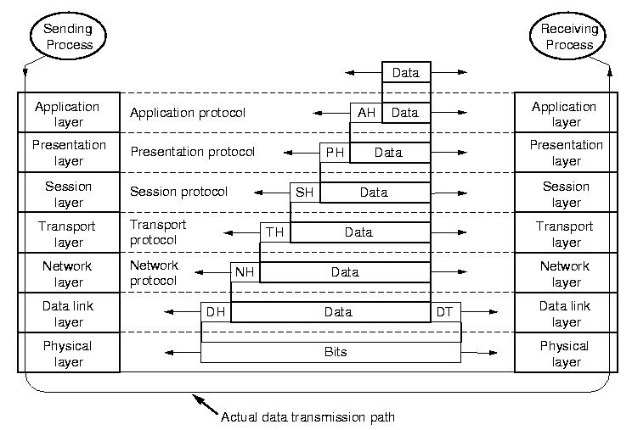
THE OSI REFERENCE MODEL
Data Transmission in the OSI Model -
Chap. 1 - Introduction

Slide 27
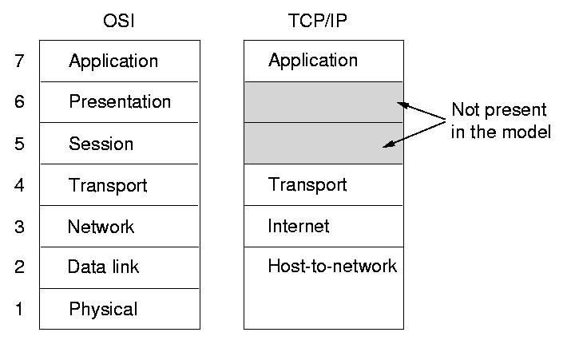
THE TCP/IP REFERENCE MODEL
The TCP/IP protocol suite is made of four layers. Used in the Internet and ARPANET. Common mechanism that is gaining on/surpassing the OSI Model.
Host to Network Layer -
This lowest level is not defined in this model. Various mechanisms abound.
Internet (Network) Layer -
Provides packet switched connectionless service.
Defines an official packet format and protocol called IP (Internet Protocol).
Deliver IP packets where they are supposed to go.
congestion control.
Chap. 1 - Introduction

Slide 28
Transport Layer -
Allows peer entities to communicate.
TCP -- Transmission Control Protocol provides a reliable connection oriented protocol that delivers a byte stream from one node to another. Guarantees delivery and provides flow control.
UDP -- User Datagram Protocol provides an unreliable connection-less protocol for applications that do not want TCP’s sequencing or flow control and wish to provide their own.
Application Layer –
It contains all the higher-level protocols.
Terminal -- Telnet
File transfer -- FTP
The Web -- HTTP
Electronic mail -- SMTP
Chap. 1 - Introduction

Slide 29
COMPARISON BETWEEN OSI & TCP/IP REFERENCE MODELS
OSI has good definition of service, interface, and protocol as discussed before. Fits well with object oriented programming concepts. Protocols are better hidden.
With TCP, the protocols came first; model was just a description of the protocols. But then the model isn't good for any other protocols.
LAYERS
Transport Network
OSI Connectionless
Connection-Oriented Connection-Oriented
TCP/IP Connectionless Connectionless
Connection-Oriented
Chap. 1 - Introduction

Slide 30
Example - Data Communications - X.25 NETWORKS
Public Networks
X.25 NETWORKS
First connection-oriented network developed during 1970's. Interface between public packet-switched networks and customers.
Operate at 64 Kpbs, so are very slow and becoming outdated. However there are still many of them in operation.
Connection oriented. Uses:
Switched Virtual Circuit - established when the first packet is sent. Circuit remains for duration of session providing in-order delivery, and flow control.
Permanent Virtual Circuit - established by agreement between the customer and the carrier. Like a leased line.
Chap. 1 - Introduction

Slide 31
Example- Data Communications - FRAME RELAY:
FRAME RELAY:
It is connection-oriented network with no error control and no flow control.
Runs at 1.5 Mbps.
Uses permanent virtual circuit between two points.
Takes advantage of modern high-speed reliable digital phone lines.
This allows simple protocols with work done by user computers rather than by the network.
Chap. 1 - Introduction

Slide 32
Standards
Issues Include:
Phone companies and the governments that regulate them.
ISO (International Standards Organization)
ANSI (American National Standards Institute)
NIST (National Institute of Standards and Technology)
IEEE (Institute of Electrical and Electronics Engineering)
IAB (Internet Architecture Board)
Chap. 1 - Introduction

